Slide 1
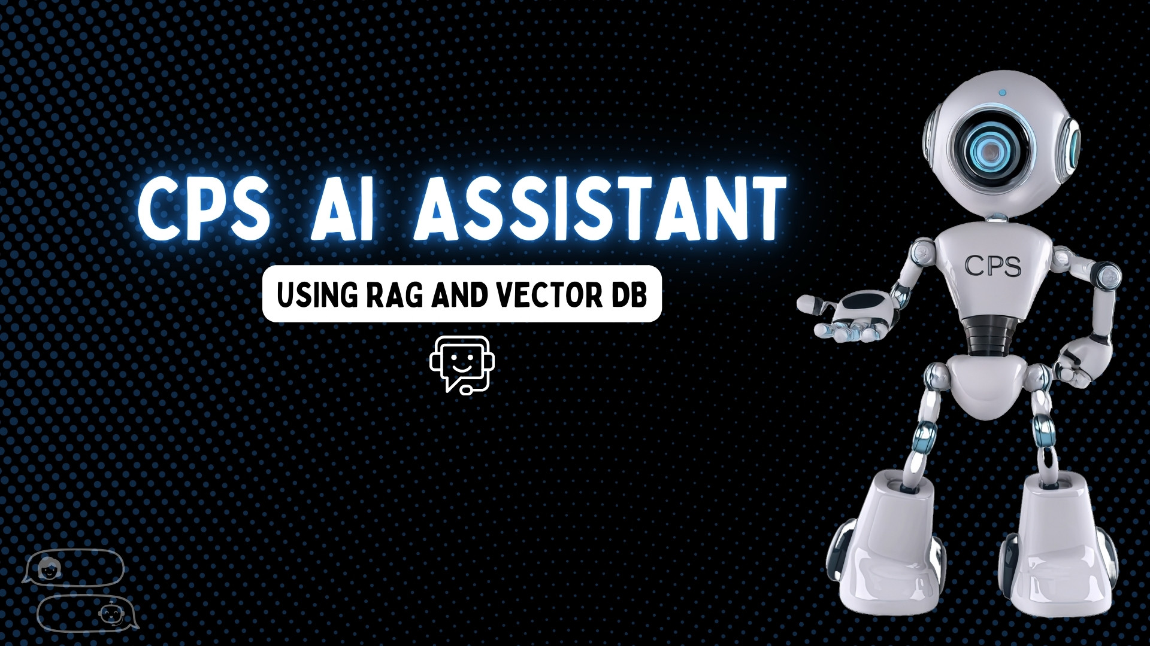
Presented By
Jibin Baby
Amos Jaimes
Rhythm Bhavsar
Nivethini Senthilselvan

Slide 2


Slide 3
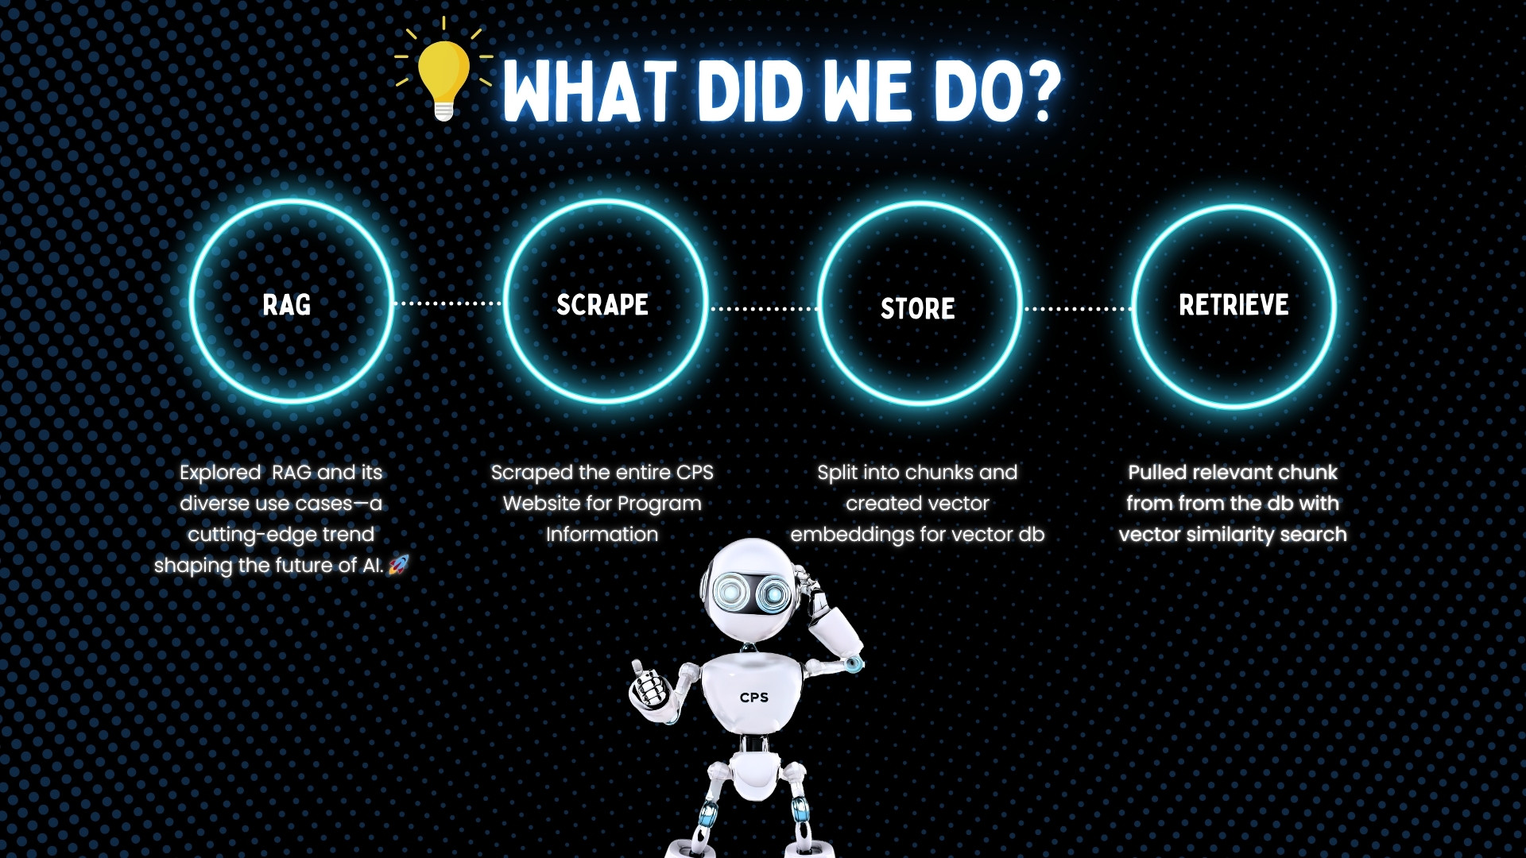

Slide 4
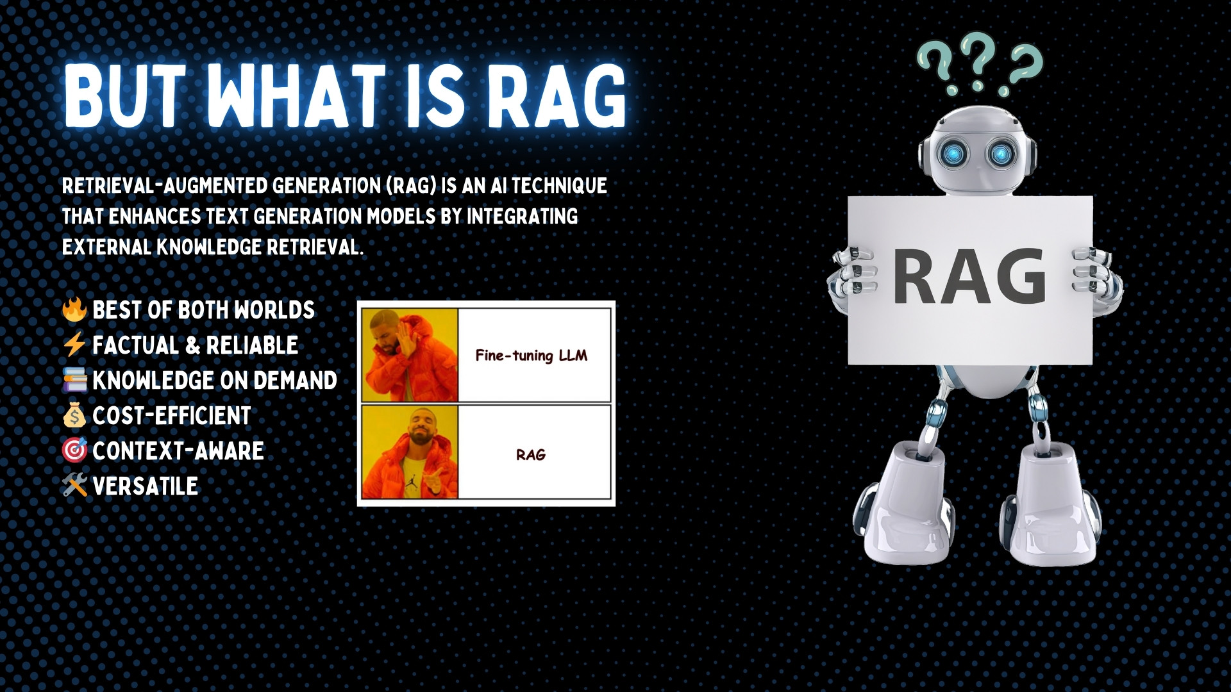

Slide 5


Slide 6
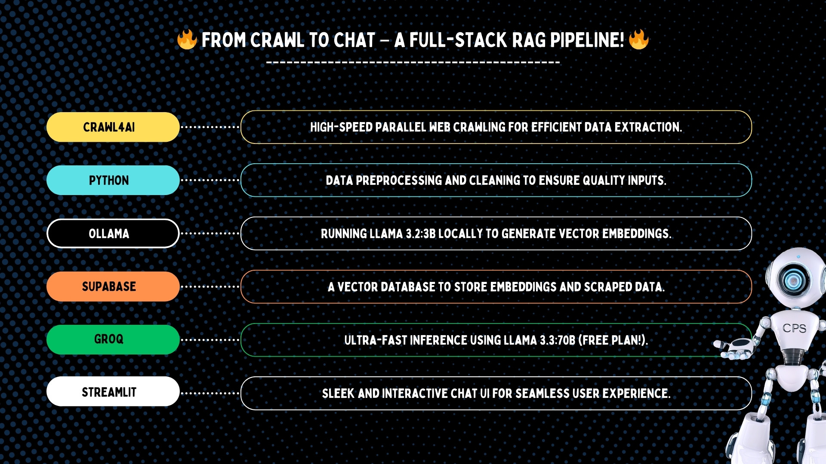


Slide 7
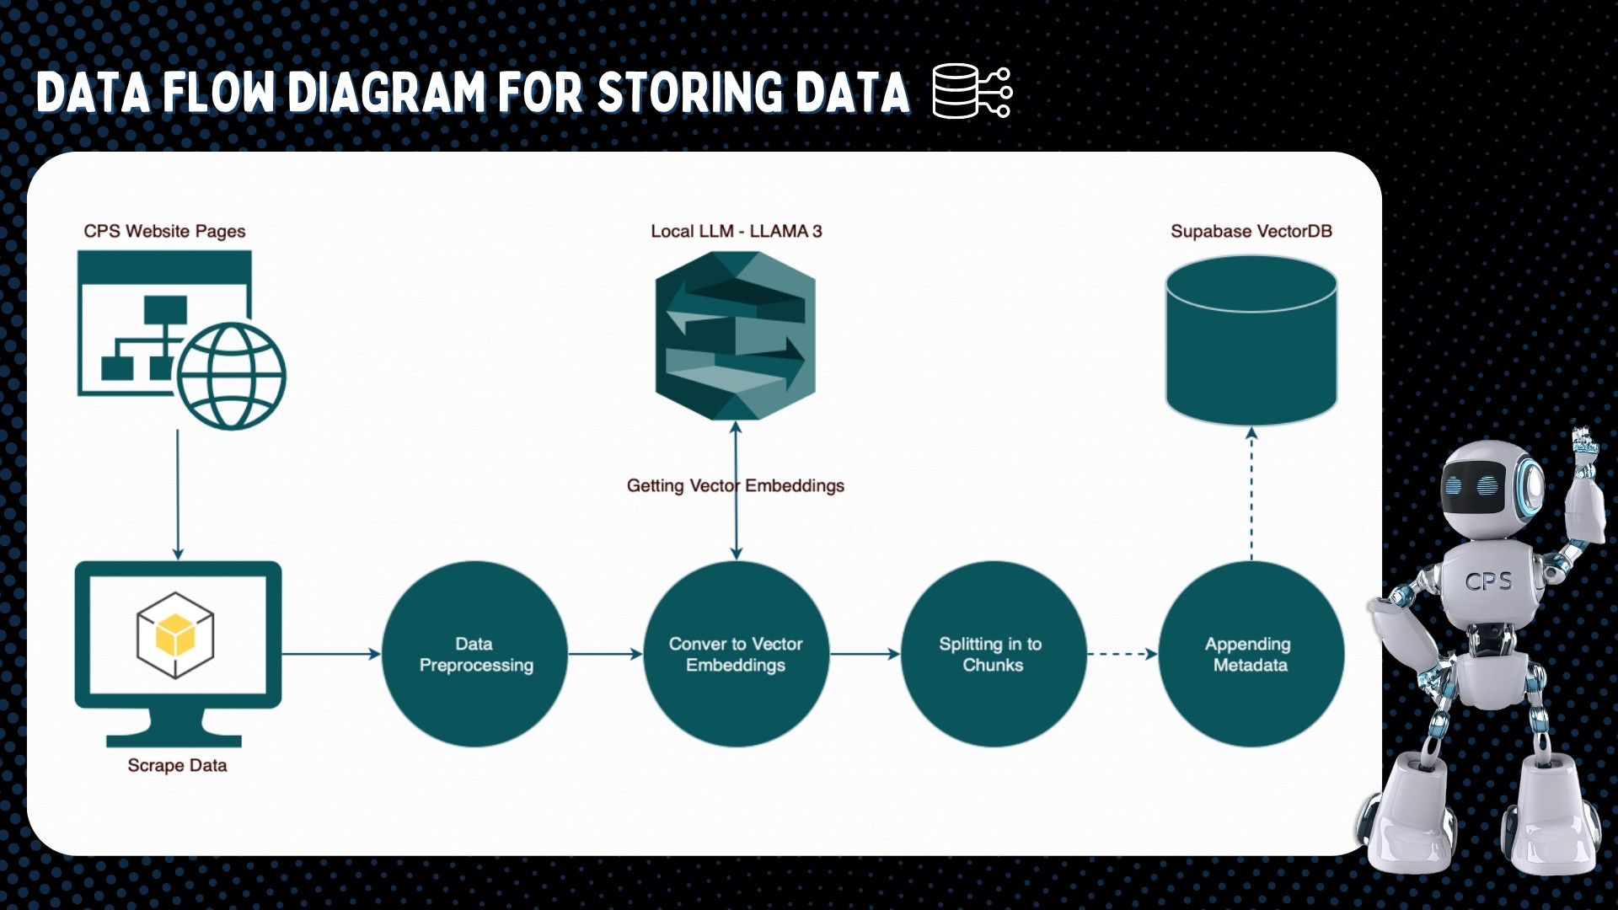
Local Nomic-embed-text model

Slide 8
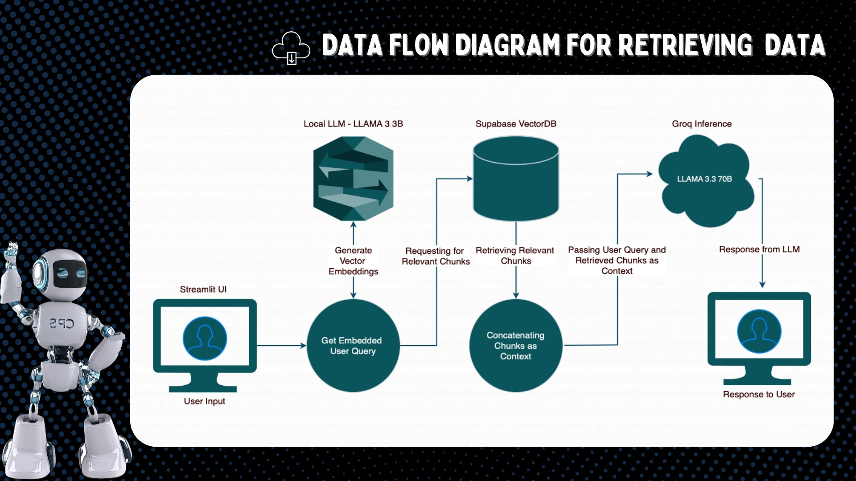
Local Nomic-embed-text model

Slide 9


Slide 10
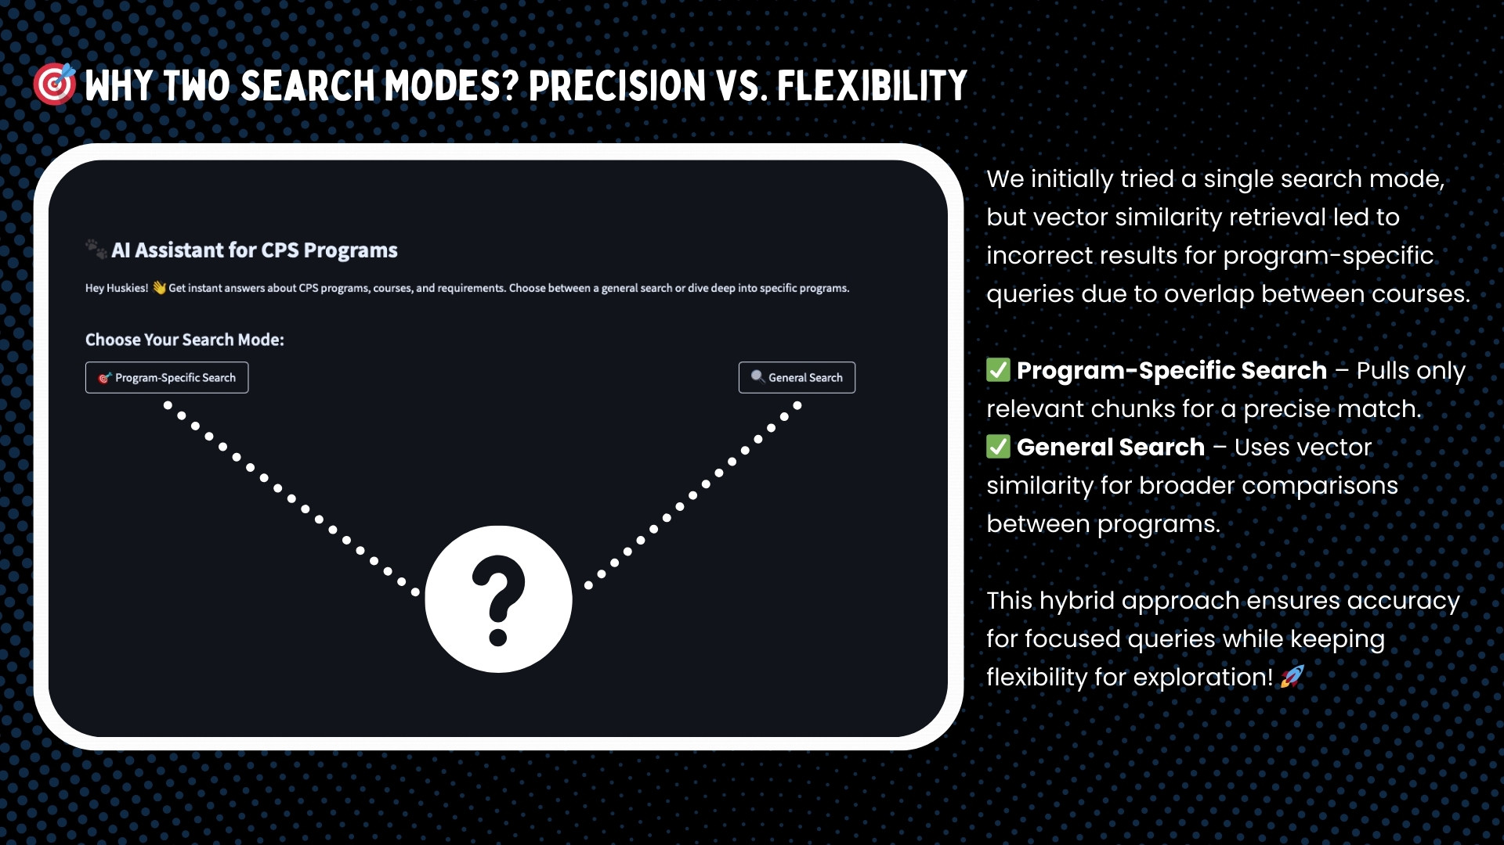

Slide 11
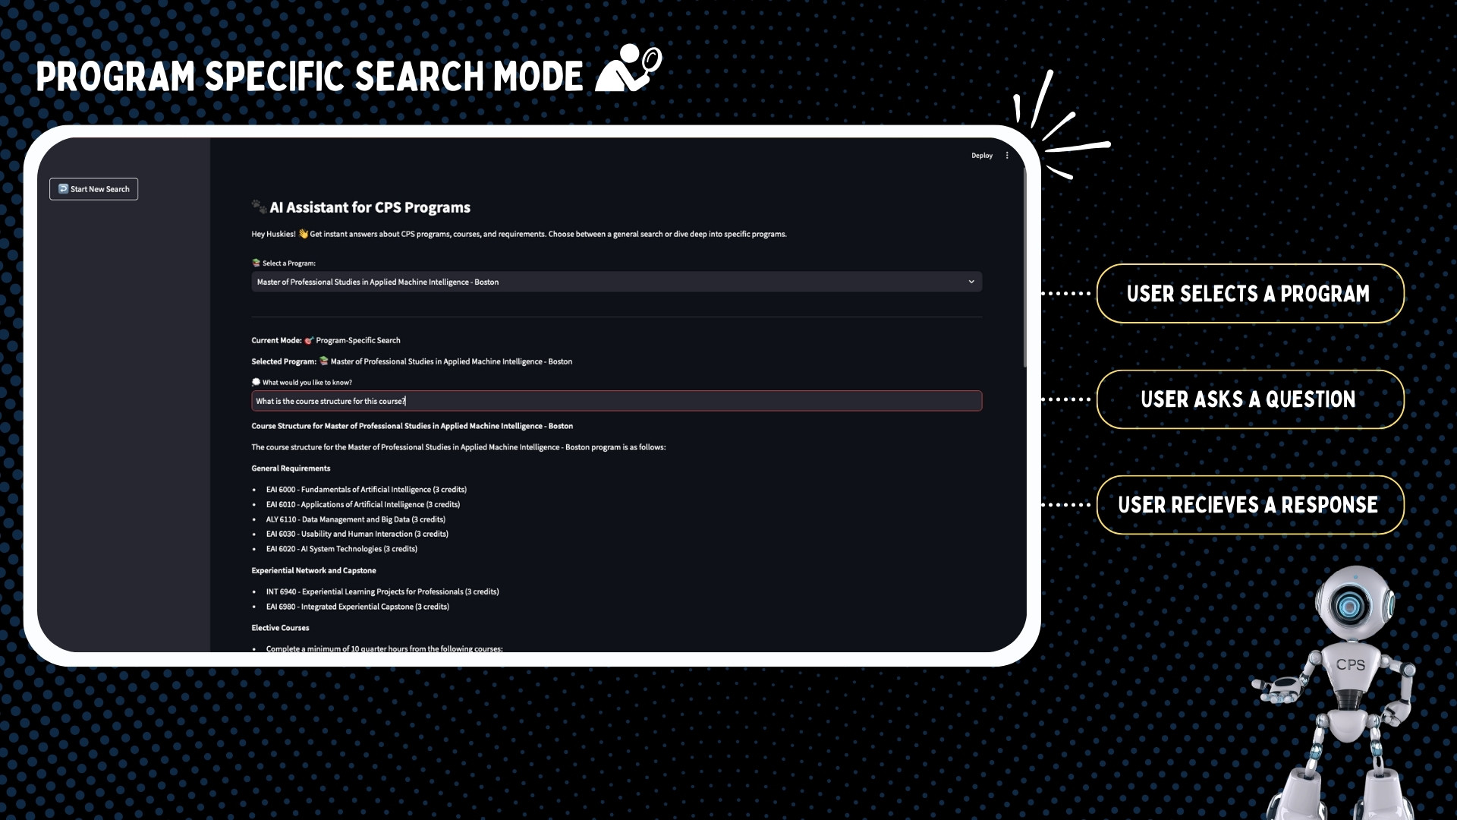

Slide 12


Slide 13


Slide 14
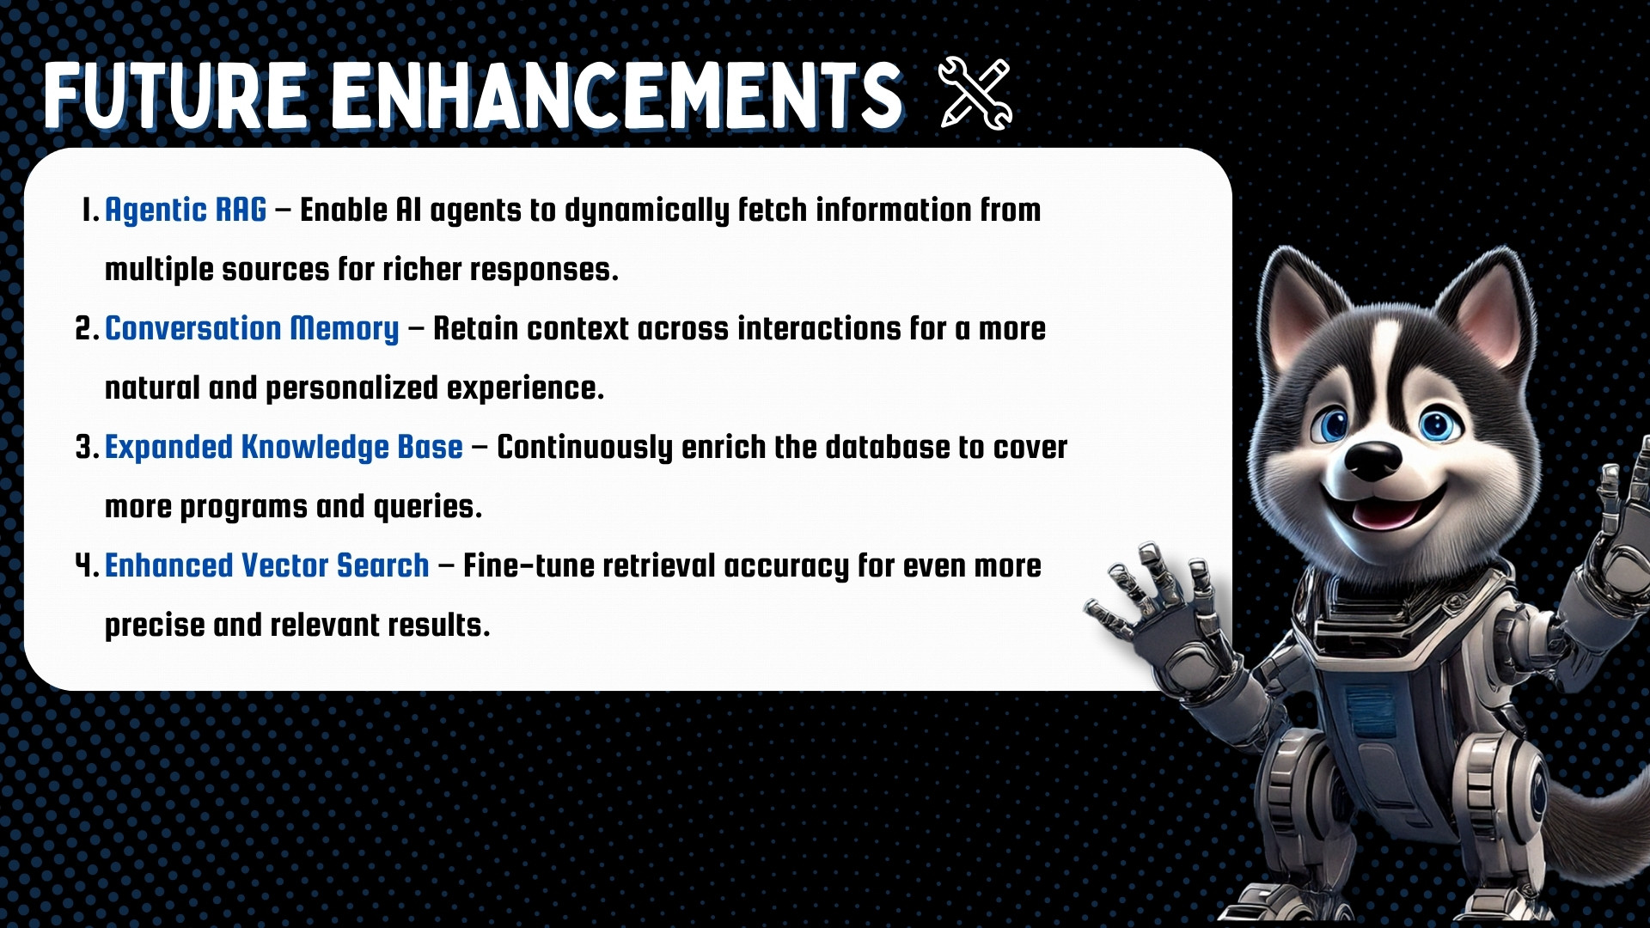

Slide 15


Slide 16


